Slide 1

DEPARTMENT OF ARTIFICIAL INTELLIGENCE AND DATA SCIENCE
Artificial Neural Networks and Deep Learning: 21ADG64
LA1 - Seminar
“DEEP LEARNING FOR OBJECT DETECTION”
Presented By
SHREYA C
[1NT21AD049]
Name of the Course Instructor Dr Meenakshi

Slide 2

CONTENTS
Introduction and Motivation
Methodology and Approach
Results and Analysis
Conclusion and Future Recommendations
Demo video of code
Github link of PPT and Code
References

Slide 3
INTRODUCTION
OBJECT DETECTION Object detection is a computer vision task that involves identifying and locating objects within images or video frames. It's like teaching a computer to recognize and label different items within visual content, much like how humans can distinguish between various objects in a scene.
Traditional Methods of Object Detection:
Sliding Window Technique: Iteratively applied classifiers to overlapping regions of the image, leading to inefficiency.
Region-Based Approaches: Proposed regions of interest were separately classified, involving multiple stages of processing.
Deep Learning Method using YOLO (You Only Look Once):
Single-Pass Inference: Processes the entire image once, directly predicting bounding boxes and class probabilities.
Unified Framework: Simultaneously performs object localization and classification in a single step.

Slide 4
WHAT IS YOLO? YOLO, short for "You Only Look Once," is a state-of-the-art object detection algorithm. Unlike traditional object detection methods that require multiple passes through an image or video frame, YOLO processes the entire image once, directly predicting bounding boxes and class probabilities. This approach enables real-time or near real-time object detection, making it ideal for applications such as autonomous driving, surveillance, and robotics. YOLO's unified framework combines object localization and classification in a single step, resulting in faster inference and high accuracy, even in complex scenes. WHAT IS DARKNET? Darknet is a neural network framework primarily used for training and deploying deep neural networks, particularly for tasks like object detection. It is known for its support of the YOLO (You Only Look Once) algorithm, which enables real-time object detection by processing images in a single pass through the network. Darknet's modular design allows for easy customization and experimentation with different network architectures and training strategies.
INTRODUCTION

Slide 5
Motivation for Using YOLO and Darknet in Object Detection: Real-Time Performance: YOLO's ability to provide real-time or near real-time object detection is crucial for applications such as autonomous driving, surveillance systems, and robotics, where rapid decision-making is essential. High Accuracy: Despite its speed, YOLO achieves competitive accuracy levels, ensuring reliable object detection even in complex scenes, making it suitable for precision-dependent applications. Efficiency: YOLO's single-pass inference architecture and Darknet's optimized framework enable efficient processing of large datasets, reducing computational overhead and speeding up deployment.
MOTIVATION

Slide 6
METHODOLOGY AND APPROACH
Setup Environment:
Use Google Colab for computing resources.
Install Darknet:
Clone Darknet from GitHub and configure for GPU support.
Download YOLO Weights:
Get pre-trained YOLO weights for object detection.
Process Video:
Upload video file for analysis.
Detect Objects:
Run object detection on the uploaded video.
Visualize Results:
Display detected objects and their confidence scores.
Calculate frames per second (FPS).

Slide 7
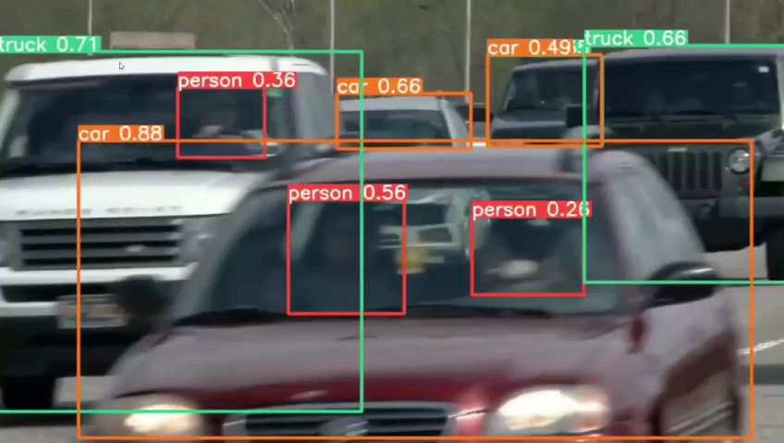
RESULTS AND ANALYSIS

Slide 8
RESULTS AND ANALYSIS
Speed and Efficiency: YOLO demonstrated real-time or near real-time performance, ensuring rapid processing of video frames, vital for applications requiring quick decision-making like surveillance or autonomous systems.
Visualization: The annotated video output provided clear visualization of detected objects, enhancing understanding of the model's performance and the objects identified in the video.
Performance Metrics: Utilizing metrics such as frames per second (FPS) and mean average precision (mAP) for quantitative assessment provided insights into the model's speed and accuracy, facilitating further optimization if required.
Challenges and Limitations: Potential challenges, such as difficulty in detecting small or occluded objects, variations in lighting, or cluttered backgrounds, were identified, suggesting areas for improvement.

Slide 9
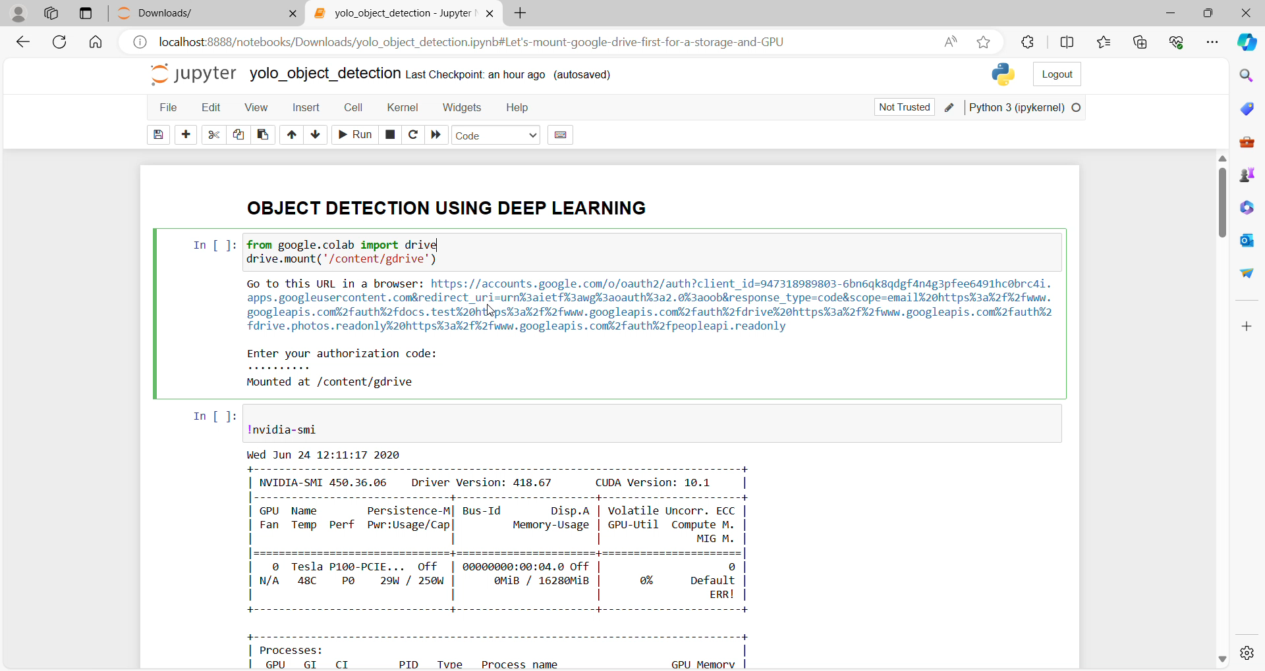
DEMO VIDEO OF CODE

Slide 10
GITHUB LINK OF PPT AND CODE
GitHub Link:
(https://github.com/ShreyaC2023/OBJECT_DETECTION)
The provided GitHub link includes the following files:
Code
PPT
README

Slide 11
REFERENCES
GitHub Repository: AlexeyAB, "Darknet" (https://github.com/AlexeyAB/darknet/).
Community forums and discussions for troubleshooting and learning.
Machine Learning Hub YouTube channel: Referenced videos for supplementary learning and insights into object detection methodologies.

